Slide 1
Shunt capacitance Affect on Transmission Lines

Slide 2
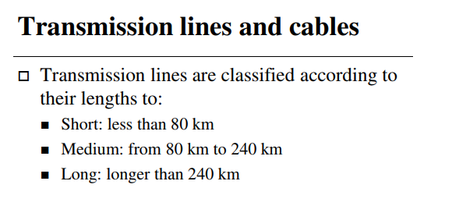
Transmission Line Model

Slide 3
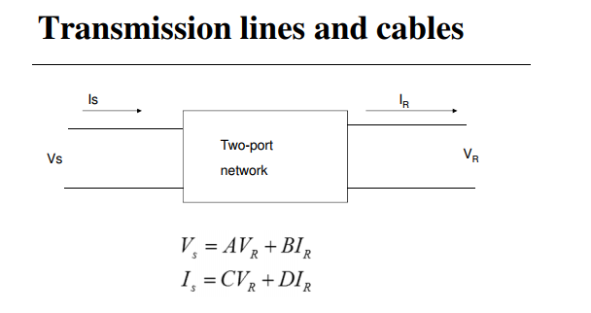
Transmission Line Model

Slide 4
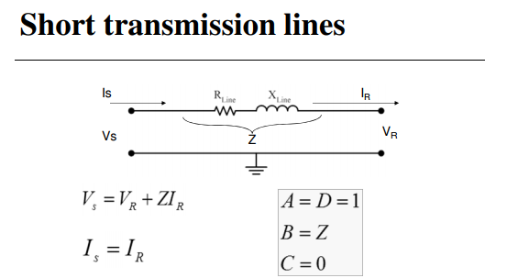
Transmission Line Model

Slide 5
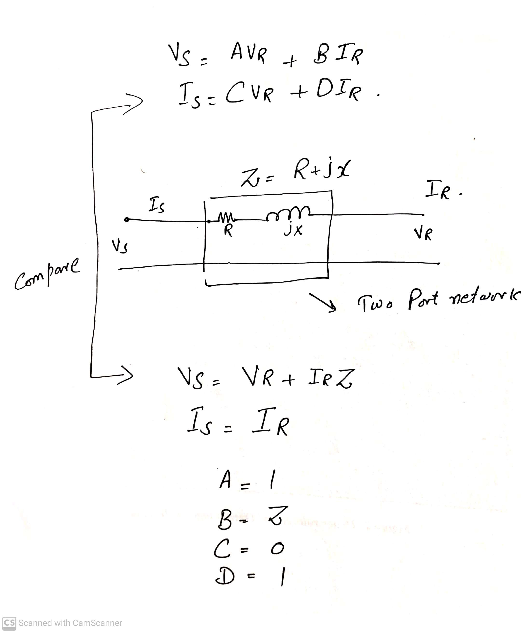

Slide 6
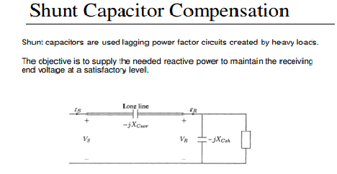
Shunt Compensation

Slide 7
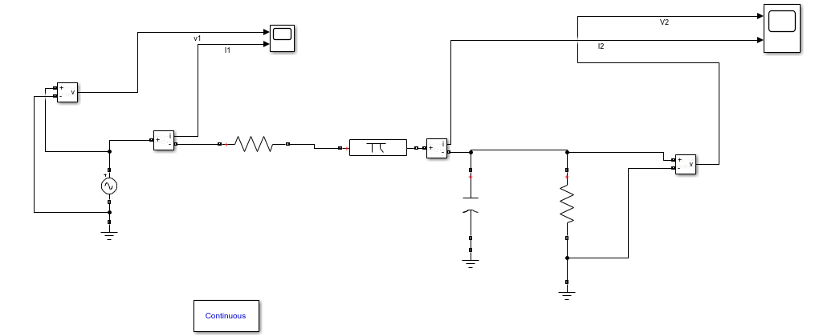
Shunt Capacitance in MATLAB/Simulink

Slide 9
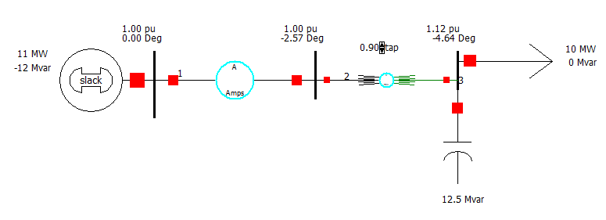
Shunt Capacitance in PWS

Slide 10
Shunt Capacitance in PWS
In PWS increase line inductance in pu and check the affect on load side Voltage in pu value.
In PWS increase line resistance in in pu and check the affect on load side voltage in PU value.
In both top cases increase or decrease the value of shunt capacitance to set close to near 1 pu.
Draw graph and table for different value of line resistance and inductances corresponding different shunt capacitance value.

Slide 11
Tasks
Simulation is done in single phase system and draw tables and graphs.
Simulation is done in three phase system and draw tables and graphs.
Simulation is performed in PWS and draw tables and graphs. See the affects by changing the transmission lines resistance and reactance alternatively.
All above tasks are done for medium transmission lines

